Slide 1
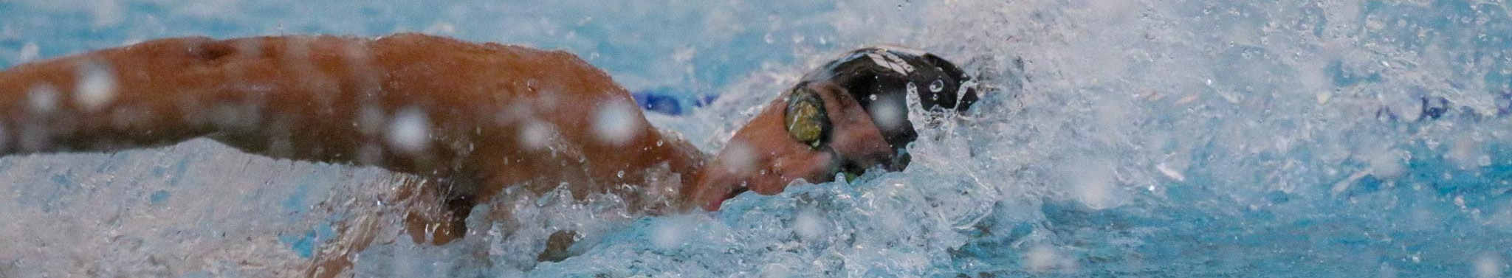

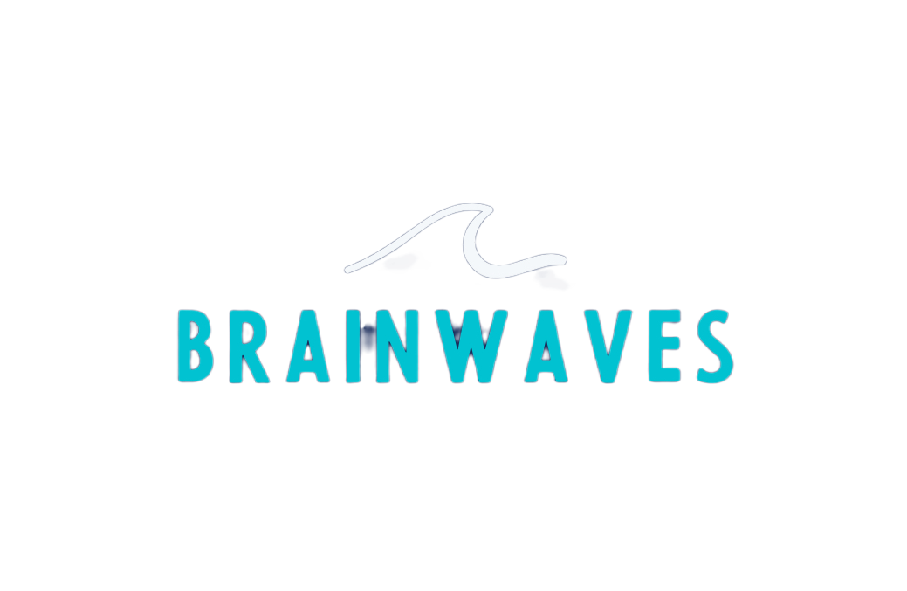

2025 SWIMPOSIUM
September 14 | Trumbull, CT
Bounce Back Stronger
Learning from Failure without Falling Apart
Jasmine Haas, Certified Mental Performance Consultant

Slide 2

About Me
  B.S. Sport and Exercise Psychology, West Virginia University
  M.S. Sport Psychology, Ithaca College
  Level II Master Resilience Trainer and Performance Expert for Army Tactical Athletes
  Association for Applied Sport Psychology Certified Mental Performance Consultant
  Director of Mental Performance, Lakeside Aquatic Club
  Owner, BrainWaves Performance

Slide 3
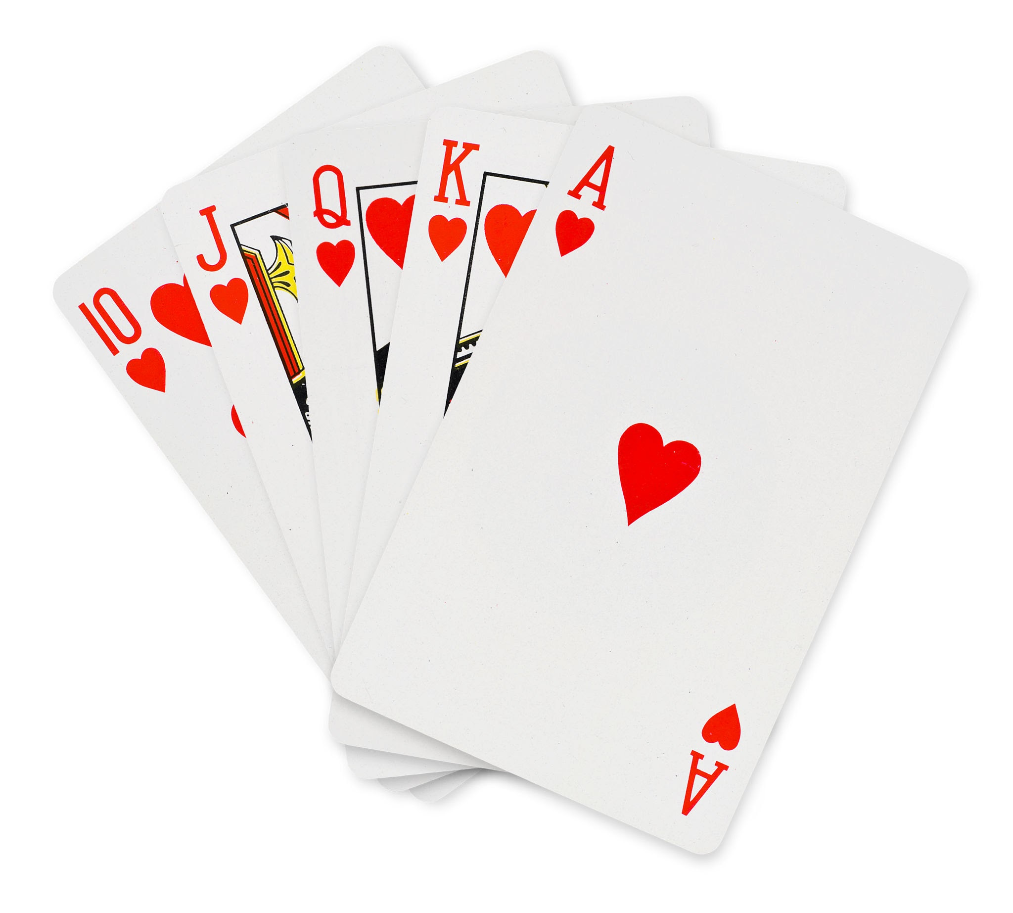
Activity: House of Cards
Notes:
Instructions:
Break into groups of 5
You will have 5 minutes to build a free standing house of cards. Be creative and work as a team to create a tall house!

Slide 4
How are we defining failure?
  As we did this activity, did you focus on only your house of cards or did you start looking at what others did?
  If your house fell over, did you get discouraged? Why or why not?
  Who won? How do you know?
Notes:
How did we define success or failure?
How do we do this in swimming?
How often do we get caught up in comparing ourself to others? How often do we get so caught up in what they are doing we lose focus on our own progress? Do we ever try to learn from them?
When we have a setback, do we try to learn from it or do we just get flustered and lose emotional control?

Slide 5
How “Failure” Shows up in our Body
Notes:
Don’t coach in a way that cues threat and danger
State drives story
Green: My coach is pushing me because they believe in me
Yellow: My coach is mad at me
Red: They hate me, I’m a failure
Listen for the NS, not just the words
Behavior = NS output, not failure
You can’t coach a kid out of red
They don’t need info, they need regulation
If you try to motivate in red it’ll come off as threatening or distant
Regulate, relate, THEN Reason in red
Kids learn best from green
Create routines to lead back to green. Make a plan
Teach kids what the zones feel like: Nervous systems shift. Smart coaching anticipates that
If your language, tone, or body language signals threat, the athlete’s NS goes to yellow and red
Even if your intention is motivating their body might not feel safe
If your system is fried, so is your team’s
It isn’t one size fits all-what regulates one might activate another. Know your athletes
Examples of threat based coaching
“This is your one chance”
“Don’t mess this up”
“If you swim like that again, you’re off the relay”
Intense eye contact + stern voice + looming posture right before a race

Slide 6
The Green Zone
CHARACTERIZED BY:
It’s the safe and social state
Present, capable of connection
Can take complex instruction, control emotions, and access motor learning in this zone
You can be hyped or calm in this zone
Breathing calm, shoulders loose
Making jokes, energetic but in control, present
Following routines
Quick recovery after mistakes
Teammates can be loud and fun
  Won’t be overstimulating

Slide 7
The Yellow Zone
CHARACTERIZED BY:
This is fight or flight kicking in
The body is mobilized for action, but not grounded
It can fuel or wreck performance
  Problem is when it becomes chaotic, not purposeful
Too much = choking, panicking
Jaw clenching, shallow breathing, tense hands
Snapping at others, withdrawing
Everything looks tight or rushed
Fixating on things like competitors or times
Top-down or bottom-up relaxation works here
  Breathing
  Naming the fear
  Movement
    Shaking out tension

Slide 8
The Red Zone
CHARACTERIZED BY:
Zombie state
Shut down, freeze response OR panic
Nervous system perceives threat, not challenge
Logic center in brain is offline, reasoning is gone
Flat affect or emotional outbursts
Slumped posture
Frozen, staring into space, not responsive
“I don’t care” “Whatever” “What’s the point?”
Withdrawing and isolating
Crying, panic breathing, or total silence
Bottom-up approaches only
Create safety
Bring presence, not pep-talks
Notes:
You can’t teach or give pep talks to someone in this zone
This zone is threat, unsafety
PFC is off
Red is not disrespect, not laziness, and not drama. When you treat it like defiance, you deepen the shutdown

Slide 9
Strategies to Bounce Back
Build control over your energy
Know how to relax and what tools work for you
Have a Pre-Performance Routine
Learn to breathe deliberately
Train your imagination
Be careful of focusing too much on feel

Slide 10
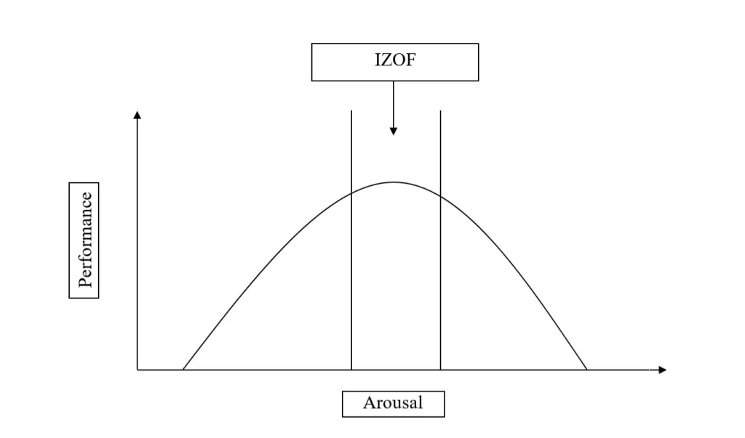
Energy Management
Energy

Slide 11
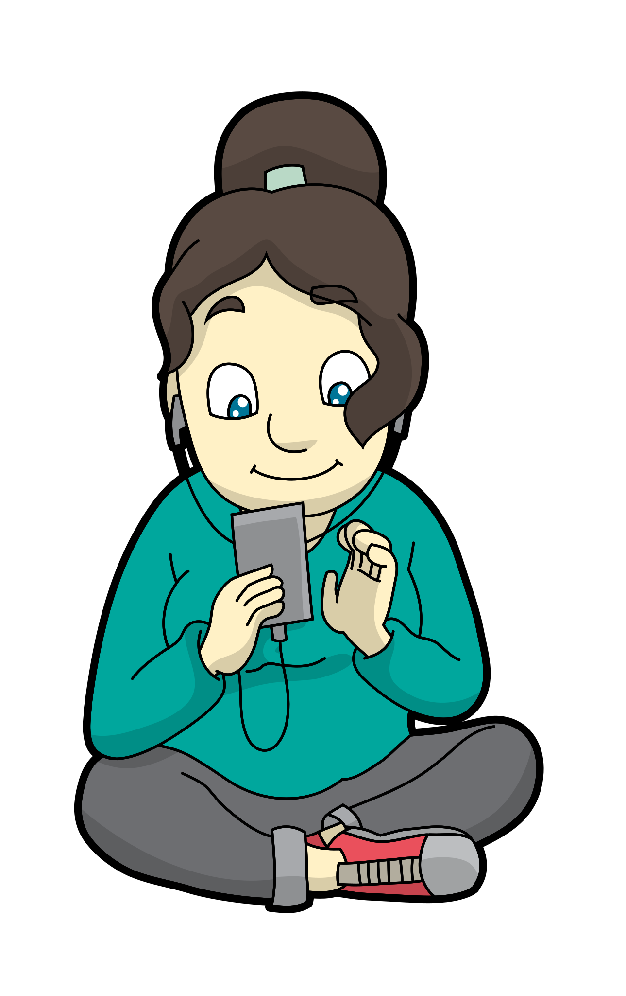

Relaxation Types
Coregulation
Self Regulation
Notes:
Worrier (aggressive relaxation)
Warrier (calm relaxation)

Slide 12
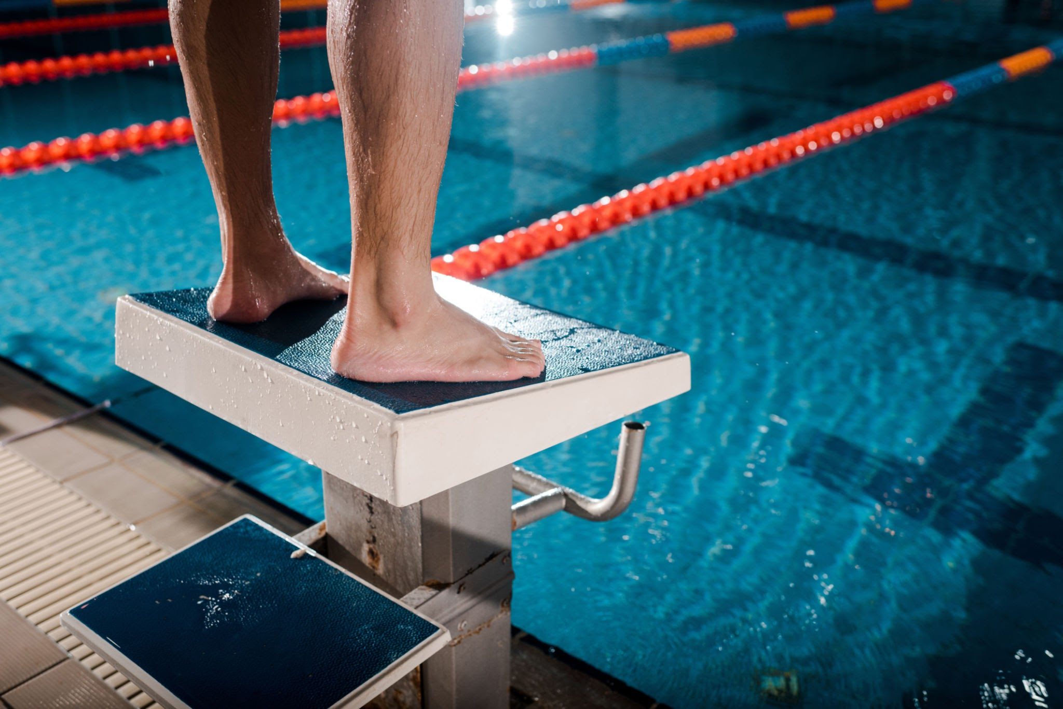
Pre-Performance Routines

Slide 13
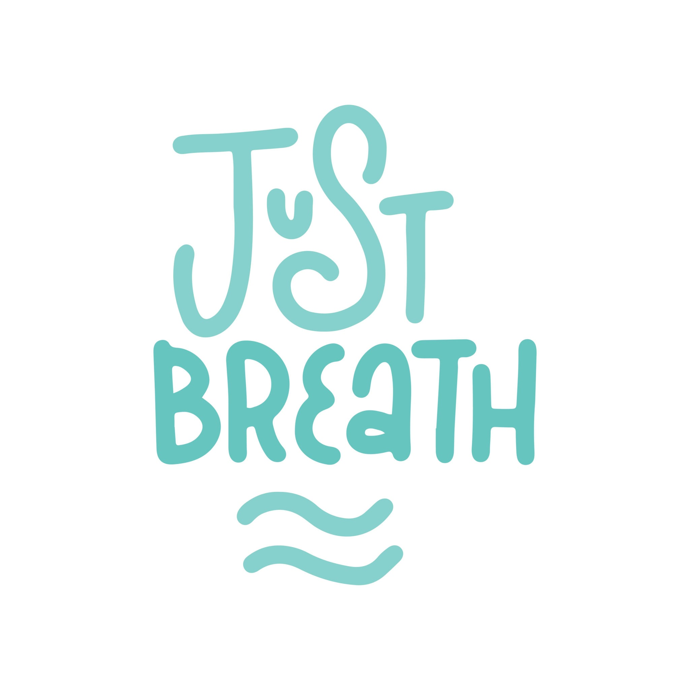
Deliberate Breathing

Slide 14

Training Your Imagination

Slide 15
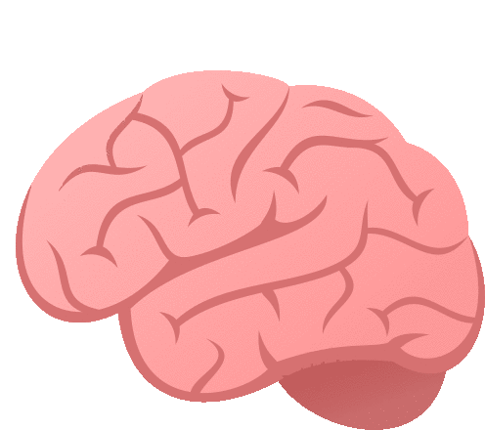


Over-Relying on “Feel”
Motor Learning Stages
Cognitive
Associative
Autonomous

Slide 16
Reinvestment Theory
When you start thinking too much about a skill you’ve already mastered, your brain tries to manually control it again, and in doing so, you mess it up
Notes:
Use external cues (feel the water, hit the wall)
Train with awareness, compete with trust
If you are trying to fix things at a meet, you’re making it practice
Sometimes that’s ok, but know your goal
Does an NFL coach work on running form on the sidelines at a game? No they watch film later and fix in practice

Slide 17
Skill #3: Know how to operate your CAR
Competency
1
Focus on strengths, capability, and what is going well.
Autonomy
2
Focus on what is in control and what choices one has
Relatedness
3
Focus on connection and belonging and make the athlete feel seen.
Notes:
When one of these dips, so does motivation. In injury almost all three nosedive.

Slide 18
Thanks for coming!
Feel free to reach out with any questions!
jasmine.haas@brainwavesperformance.org

