Slide 1
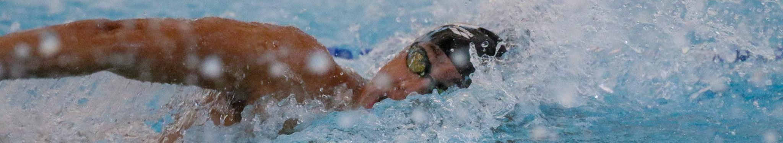

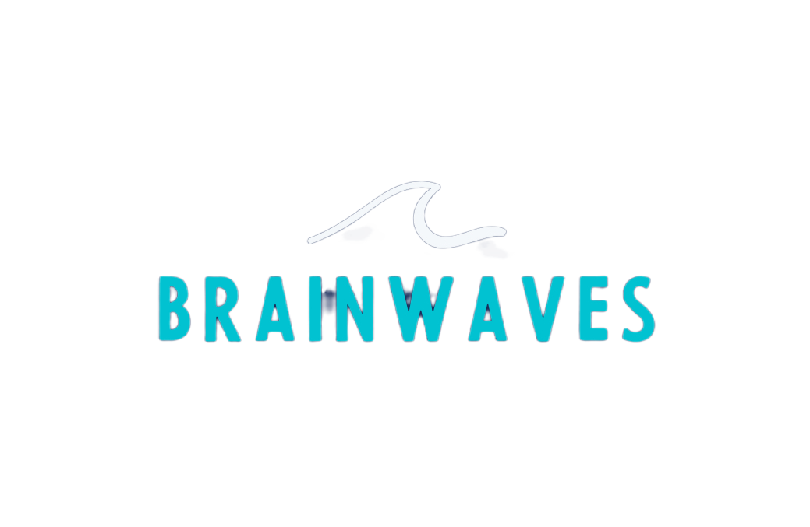

2025 SWIMPOSIUM
September 14 | Trumbull, CT
Coaching the Brain
Mental Skills Every Coach Should Understand
Jasmine Haas, Certified Mental Performance Consultant

Slide 2

About Me
  B.S. Sport and Exercise Psychology, West Virginia University
  M.S. Sport Psychology, Ithaca College
  Level II Master Resilience Trainer and Performance Expert for Army Tactical Athletes
  Association for Applied Sport Psychology Certified Mental Performance Consultant
  Director of Mental Performance, Lakeside Aquatic Club
  Owner, BrainWaves Performance

Slide 3
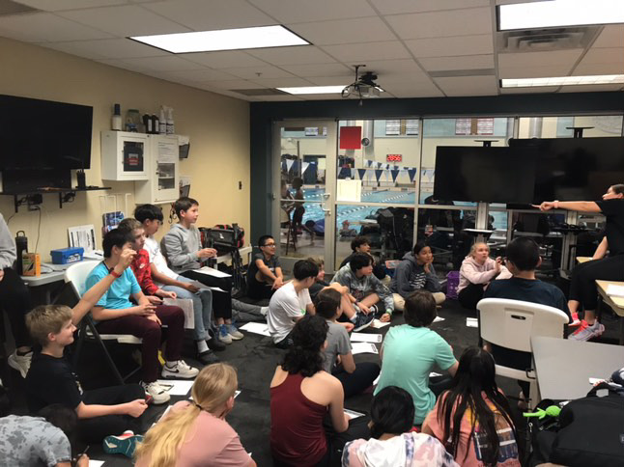
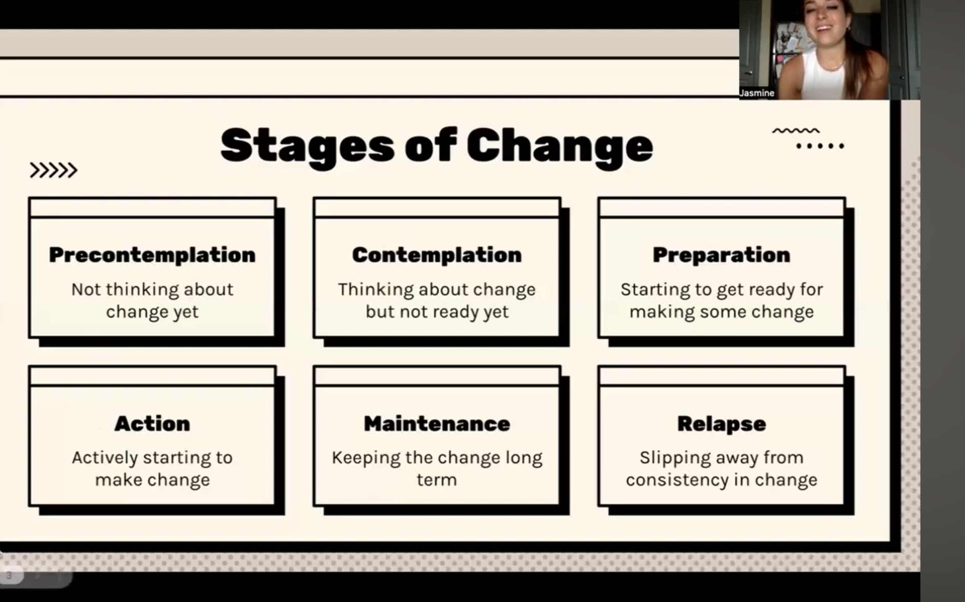
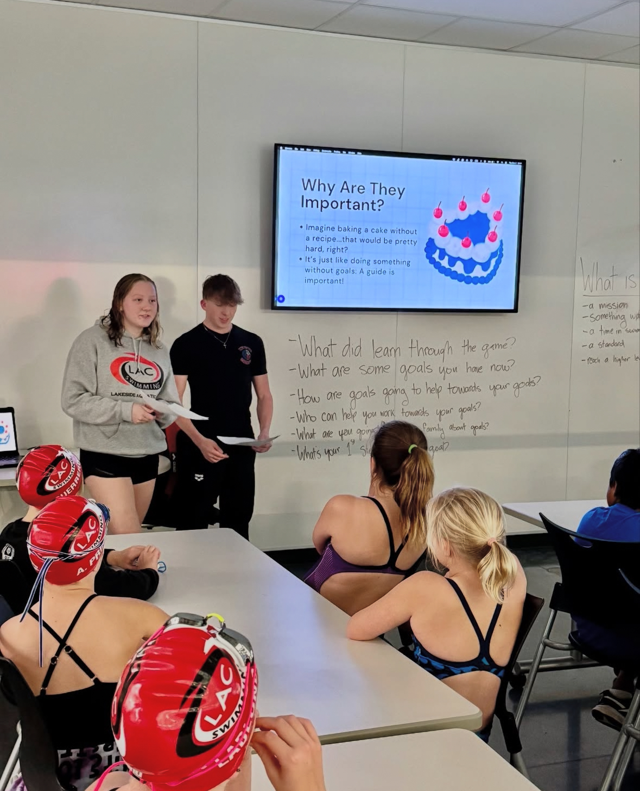
Mental Performance Programming
  Competitive groups ages 11-18
  30 minute sessions once a week
    Virtual resources
  Individual support for athletes on deck
    Safe Sport
  Intern program
  Collaboration with coaches
  Parent education

Slide 4
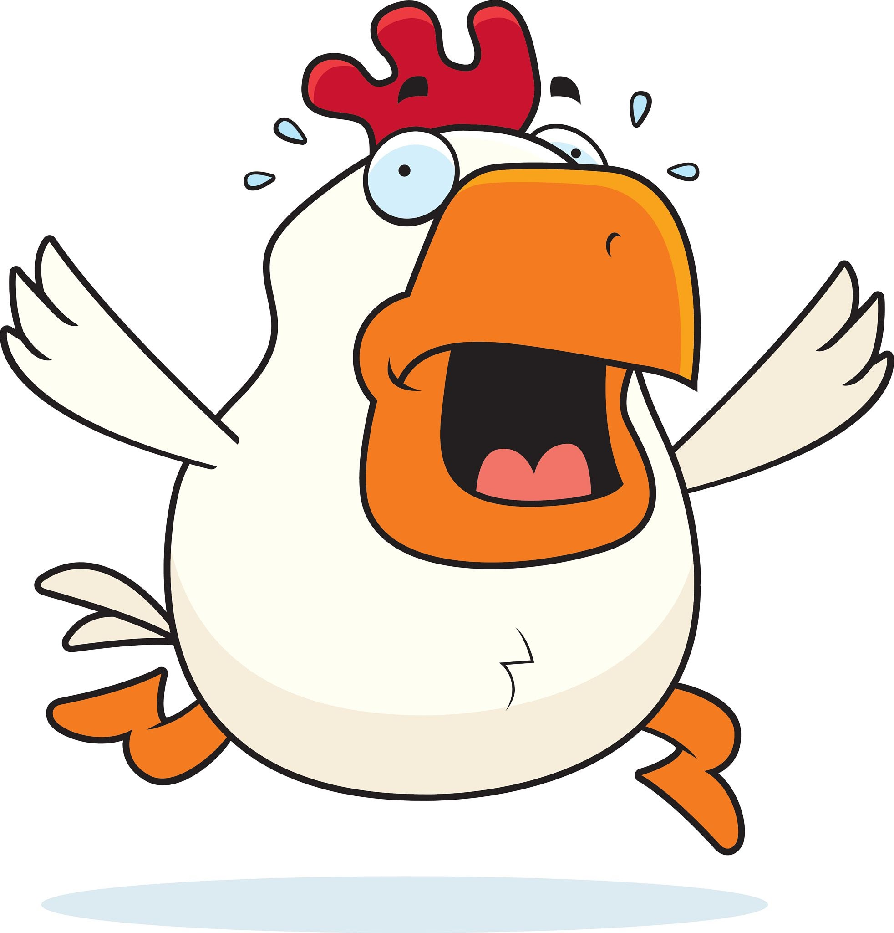
Activity: Chicken Scratch
Notes:
Instructions:
You have 20 seconds to draw an animal
How did that feel? Easy? Automatic? Anyone overthink it?
2. Now try again, but this time I want you to pair up with someone near you. They are going to coach you through it step-by-step-they get to pick the animal. Coaches, you may not use any gestures, just words. And you must use your non-dominant hand to draw it.
If someone says it was easier to be coached
-When stakes are low and you’re sitting in a chair with a pen, structured step-by-step coaching can feel helpful. This is the cognitive stage
-But imagine you’re doing this under pressure
-Imagine your mom, your ex and your boss are all watching you and Rowdy Gaines is commentating every move you make
*The reason I had you switch from dominant to non-dominant is because it forces de-automation, the same way our brain makes our motor patterns less automated when we focus on a motor task

Slide 5
Discussion: Chicken Scratch Activity
Which animal came out better, your first or second?
How did the second drawing feel compared to the first drawing?
If I had to put you on stage to draw that second animal in front of 500 people, how confident would you feel?
Have you ever seen an athlete look great in practice, and fall apart under pressure?
  What do you think causes that drop-off? Is it physical or cognitive?

Slide 6
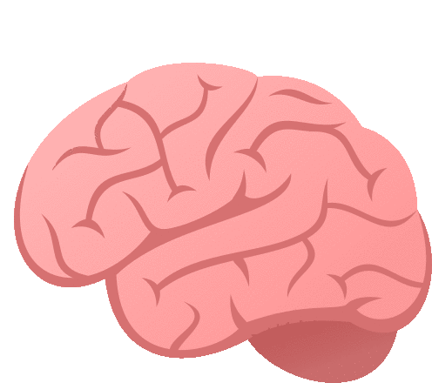


Skill #1: The Art of Coaching
Outside the Box
Motor Learning Stages
Cognitive
Associative
Autonomous

Slide 7
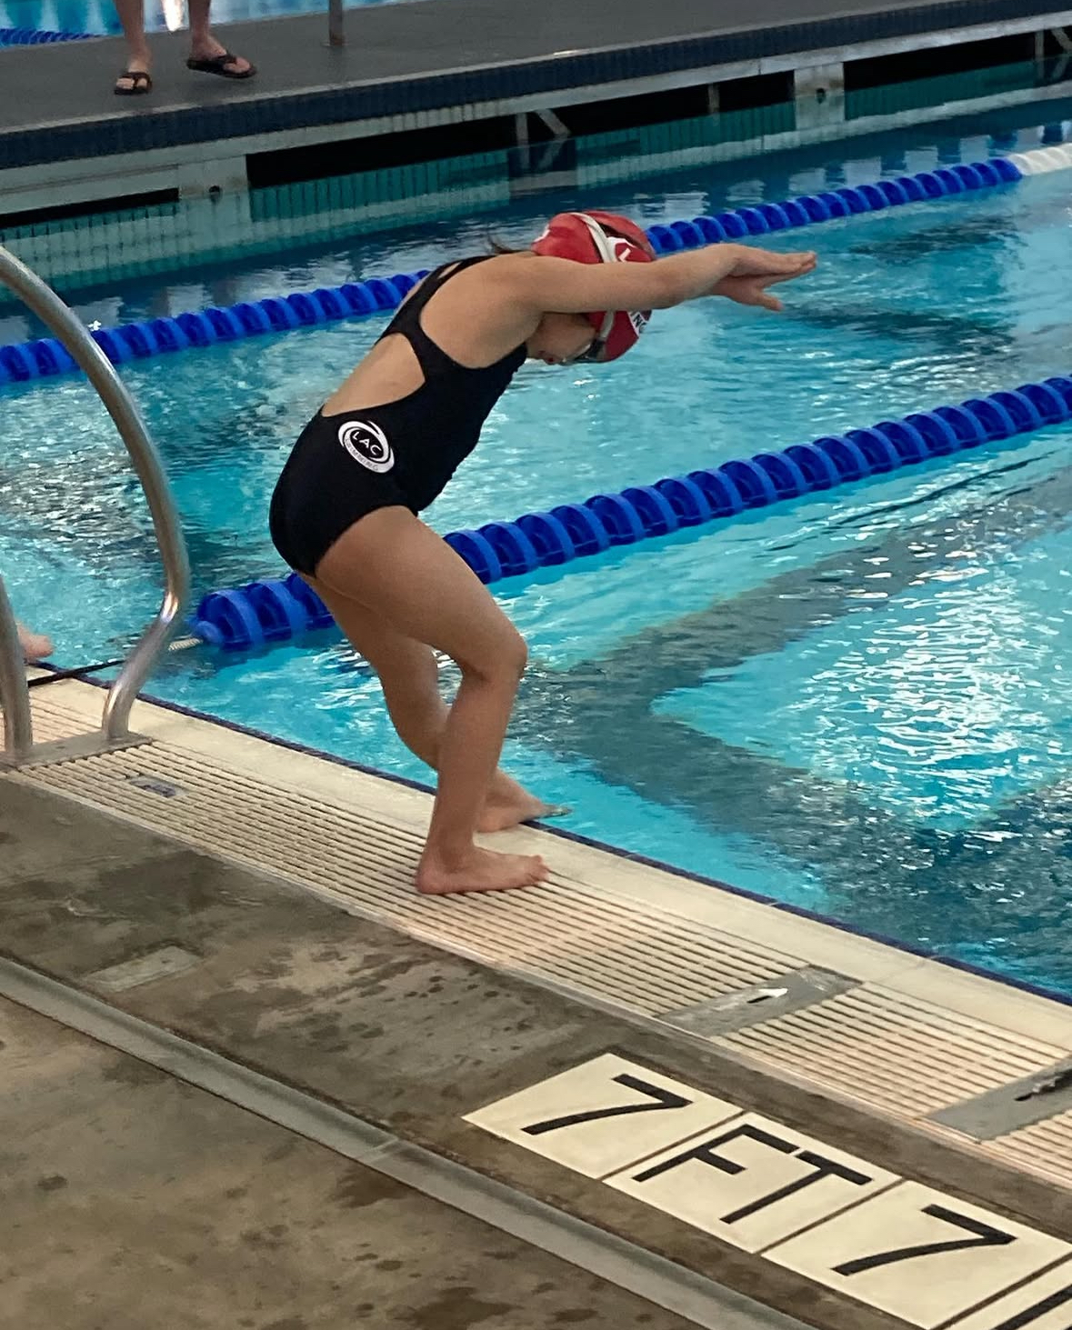
Motor Learning: Cognitive Stage
  Characterized by:
    Athlete is figuring out the movement
    Performance is inconsistent and full of errors
    They need lots of conscious thought and external feedback
    Overthinking is normal here (and kind of unavoidable)
    Prefrontal cortex is the main driver here
Notes:
When we make a huge change to technique they will go back to cognitive stage in that domain and will have to work their way back up the stages
Reinvestment theory: the more an athlete starts thinking about their own body mid-task, the more they interrupt fluent motor execution
Keep internal focus during learning, during regulation and post race or between sets
Avoid internal focus mid performance, during highly automatic movements, with anxious or perfectionistic athletes
If they are in yellow or red zone of nervous system you may think they are still in cognitive stage when they’re not
Poor regulation = blocks access to stored motor programs
So if a kid suddenly forgets how to swim a 200 fly it’s not always motor regression, it might be nervous system interference

Slide 8
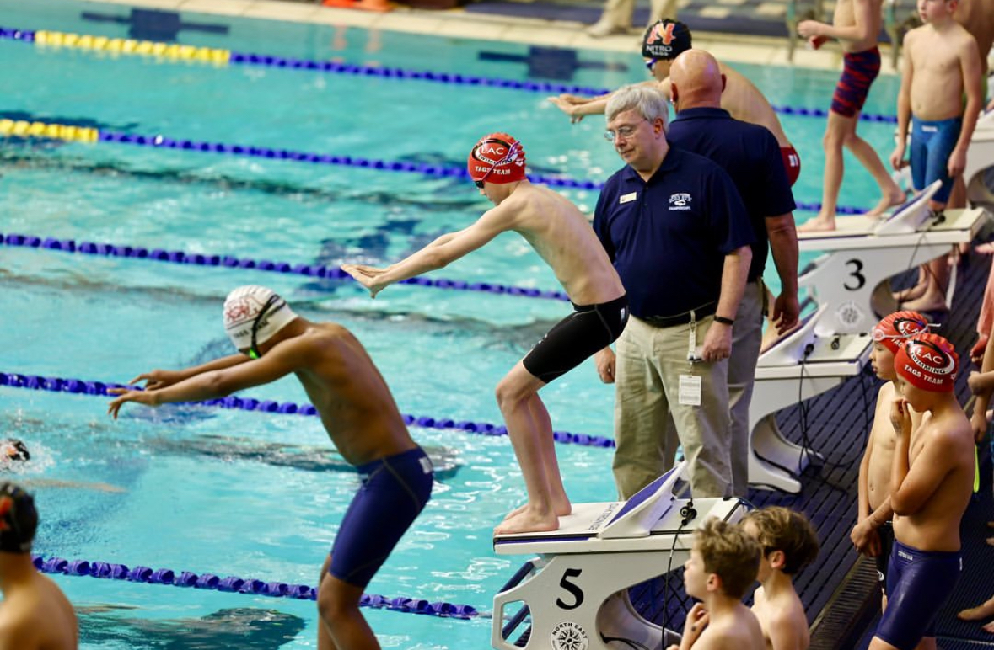
Motor Learning: Associative Stage
  Characterized by:
    Technique is improving
      Fewer errors
    Athlete can self-correct and is more consistent
    Less mental energy required, but still needs focused reps
    This is where real refinement and coaching happens
    Try → Feel → Adjust → Repeat → Refine
Notes:
PFC is still involved but takes more of a consultant role than being the CEO
Habit center (Basal Ganglia)
Cerebellum (error corrector and rhythm tuner)
Premotor cortex (plans what to do next)
Primary motor cortex (sends signals to muscles)
Somatasensory cortex (feel it feedback zone)

Slide 9
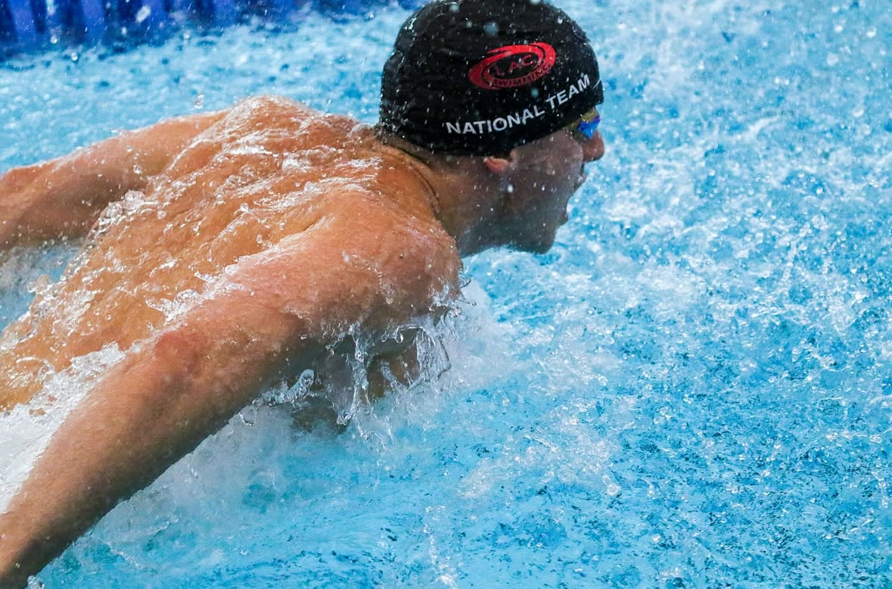
Motor Learning: Autonomous Stage
CHARACTERIZED BY:
Skill is automatic
Athlete can perform under pressure or fatigue
They can now use that skill in combo with other skills (strategy, adaptation)
If they look bored during drills but dominate during performance, they’re likely autonomous
PFC is too slow, deliberate, and energy demanding to run elite performance. If it’s leading during a meet you’re probably:
  Learning something new
  Anxious and over-monitoring
  Choking under pressure

Slide 10
Reinvestment Theory
When you start thinking too much about a skill you’ve already mastered, your brain tries to manually control it again, and in doing so, you mess it up
Notes:
Studies show swimmers do better when they are not prompted to think about their technique before a race
NFL analogy
Use external cues (feel the water, hit the wall)
Train with awareness, compete with trust
If you are trying to fix things at a meet, you’re making it practice
Sometimes that’s ok, but know your goal
Does an NFL coach work on running form on the sidelines at a game? No they watch film later and fix in practice

Slide 11
Discussion
Where in your coaching do you think you might accidentally interrupt skill automation?
Where do you find yourself overcoaching and why?
What could you do differently at a meet to optimize performance and avoid triggering choking accidentally?
    Is there anything you would do the same?

Slide 12
Skill #2: How to Coach the Nervous (System)
Notes:
Don’t coach in a way that cues threat and danger
State drives story
Green: My coach is pushing me because they believe in me
Yellow: My coach is mad at me
Red: They hate me, I’m a failure
Listen for the NS, not just the words
Behavior = NS output, not failure
You can’t coach a kid out of red
They don’t need info, they need regulation
If you try to motivate in red it’ll come off as threatening or distant
Regulate, relate, THEN Reason in red
Kids learn best from green
Create routines to lead back to green. Make a plan
Teach kids what the zones feel like: Nervous systems shift. Smart coaching anticipates that
If your language, tone, or body language signals threat, the athlete’s NS goes to yellow and red
Even if your intention is motivating their body might not feel safe
If your system is fried, so is your team’s
It isn’t one size fits all-what regulates one might activate another. Know your athletes
Examples of threat based coaching
“This is your one chance”
“Don’t mess this up”
“If you swim like that again, you’re off the relay”
Intense eye contact + stern voice + looming posture right before a race

Slide 13
The Green Zone
CHARACTERIZED BY:
It’s the safe and social state
Present, capable of connection
Athletes can take complex instruction, control emotions, and access motor learning in this zone
You can be hyped or calm in this zone
LOOKS LIKE:
Smooth, controlled movement
Fluid breathing
Responsive to cues
Light humor or connection
Body language is upright but relaxed
Quick recovery after mistakes
IN THIS ZONE YOU CAN:
Introduce new skills and cues
Review mistakes
Set goals and expectations
Build connection
Praise behavior and strategy
COACHING GREEN:
In this zone you’re not rambling or explosive
You can pause before reacting
You have open body language in this zone
If you’re not in green, they won’t stay in green either
  Your nervous system sets the tone, even if you’re silent athletes pick up on it fast

Slide 14
The Yellow Zone
CHARACTERIZED BY:
This is fight or flight kicking in
The body is mobilized for action, but not grounded
It can fuel or wreck performance
  Problem is when it becomes chaotic, not purposeful
Too much = choking, panicking
LOOKS LIKE:
Jaw clenching, shallow breathing, tense hands
Snapping at others, withdrawing
Everything looks tight or rushed
Fixating on things like competitors or times
IN THIS ZONE YOU CAN:
Use short, grounding cues
Acknowledge tension without adding more
Model regulation
Help them separate from thoughts and use body relaxation tools
Channel energy rather than fighting it
COACHING YELLOW:
If you find yourself in yellow you might start overcoaching
You tend to get more critical in this stage
You might find you have less patience for athlete emotions
You might get more controlling
You might talk faster or louder or pace more

Slide 15
The Red Zone
CHARACTERIZED BY:
Zombie state
Shut down, freeze response OR panic
Nervous system perceives threat, not challenge
PFC is offline, reason and logic are gone
LOOKS LIKE:
Flat affect or emotional outbursts
Slumped posture
Frozen, staring into space, not responsive
“I don’t care” “Whatever” “What’s the point?”
Withdrawing and isolating
Crying, panic breathing, or total silence
IN THIS ZONE YOU CAN:
Regulate first, everything else can wait
Say less, just be a presence
Use grounding tools
Don’t rush to fix
Model calm
Distract
COACHING RED:
Raised voice or total silence
Snapping at kids, blaming them, quitting mid season
Hyper fixating on control
Complete detachment
Things become all or nothing
You tune out
Notes:
You can’t teach or give pep talks to someone in this zone
This zone is threat, unsafety
PFC is off
Red is not disrespect, not laziness, and not drama. When you treat it like defiance, you deepen the shutdown

Slide 16
Skill #3: Know how to operate your CAR
Competency
1
Focus on strengths, capability, and what is going well.
Autonomy
2
Focus on what is in control and what choices one has
Relatedness
3
Focus on connection and belonging and make the athlete feel seen.
Notes:
When one of these dips, so does motivation. In injury almost all three nosedive.

Slide 17
Skill #4: Don’t do too much
Frequency of Feedback
  Give feedback on some reps, not every rep
    Give feedback every 3rd or 4th rep
      33% of the time is what you’re aiming for
    You can also fade your feedback
      Give more early on, then taper off
    Note: you will see worse reps in practice, BUT way better performance under pressure later
Bandwidth Frequency
  Only give feedback when the athlete falls outside a set error range
    They self correct when they’re close and learn to rely on feel, not you
Self Controlled Feedback
  Athletes choose when they want feedback
  Boosts motivation, ownership, and deeper thinking
  Builds trust and keeps them engaged
Error Estimation
  Athlete reflects on performance before you give feedback
Builds awareness, calibrates internal feedback sensors

Slide 18
Skill #4 (revised) Less is More
Frequency of feedback
  Give feedback every 3rd or 4th rep
Bandwidth feedback
  Only give feedback when they fall outside a set error range
Self Controlled Feedback
  Athletes choose when they want feedback
Error Estimation
  Athlete reflects on performance before you give feedback
Notes:
Tell story of Steve at retreat
Frequency of Feedback
-You will see worse performance at first in practice but significantly better performance outcomes under pressure later
Bandwidth feedback
-If you want your swimmers to be more self sufficient and rely on feel for feedback, not you
Self Controlled feedback
-Boosts motivation, ownership, and deeper thinking
-Builds trust and keeps them engaged
Error Estimation
-Builds awareness, calibrates internal feedback sensors

Slide 19
Thanks for coming!
Feel free to reach out with any questions!
jasmine.haas@brainwavesperformance.org

